Slide 1
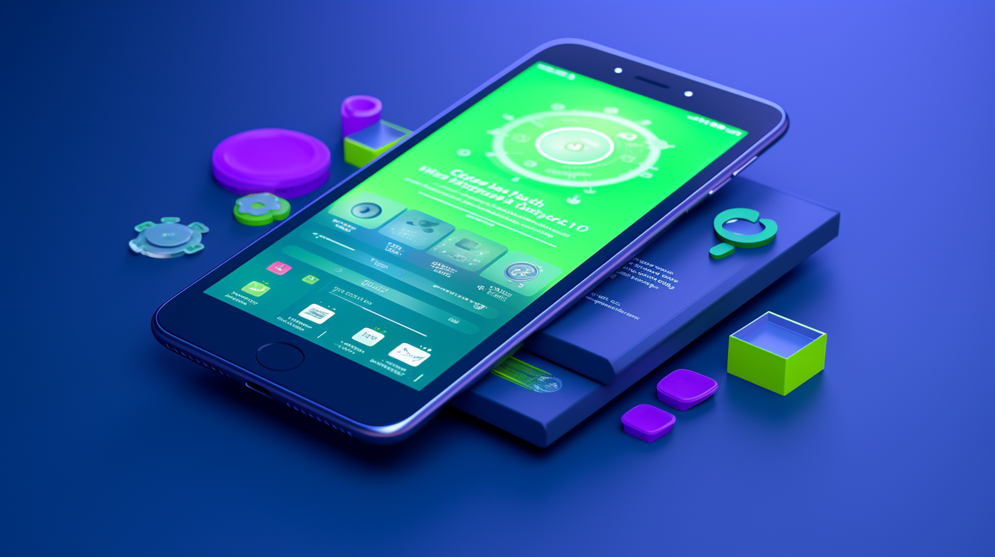
Prof Sam Chan
COMM3131 Online Dating and Hookup Culture
WORKSHOP 2 |
BEST APP OF THE WOLRD
Notes:
Image: https://cdn.sanity.io/images/tlr8oxjg/production/fe5795af341f222b6b33ebce00659f188088821b-1456x816.png?w=3840&q=80&fit=clip&auto=format

Slide 2
Recap: Articulating design features and the goal of your app
A pop-up box after two weeks: “Do you want to meet this person in real life?”
Yes = a date will be suggested
No = profiles will be unmatched immediately
Modality switching
Long-term relationship
This feature demands users to either switch modality or move on to another target – don’t waste people’s time.

Slide 3
Recap: Articulating design features and the goal of your app
Features
Interpersonal process
Relational goals
Affordance

Slide 4
Today
A group of 5 persons (i.e., six groups in total)
Create a name for your app ☺
In 75 minutes
Envision your “ideal” app – types of relationships, users?
Apply theories/concepts from Meetings 2 to 4 and 6 (assessment criteria)
Create an 8-minute presentation using papers and pens
The most compelling design will receive highest points (15 points)
Original/innovative designs will also receive bonus points
Take questions (not graded; really for questions)
Notes:
930 – 945 : Introduction
945 – 1100: Design
1110
1120
1130
1140
1150
1200

Slide 5
Participation
A 300-word reflection
Critically reflect on the design process: what did your design do best? what can be improved? overall, what did you learn?
In the reflection, show an at least one comparison with the design of another group
Submit your reflection to Blackboard before 9pm Hong Kong time tonight
Take some 15 mins to recall and reflect

Slide 6
App Pitch (25 points)
Your task: to design a new app for dating/
hookups
a) Studying the experiences and challenges of a pre-identified group of dating app users (see our course outline) through secondary research.
b) Evaluating existing apps that serve the same group of users.
c) Suggesting a theoretically driven design of the app (only very basic drawings are expected)

Slide 7
App Pitch (25 points)
Format
a) Not more than 1,100 words (excluding references)
b) Use any consistent referencing style
c) First, submit your assignment to VeriGuide and get a VeriGuide Receipt; then submit your assignment and the receipt together
d) AI tools for proofreading/language fluency (e.g., Grammarly) without acknowledgement is allowed but I reserve the right to see your unpolished assignment

Slide 8
Due: 11:59 pm on July 27 (Monday)
Every day of late submission will result in a deduction of 5 points (out of 25); anything submitted after 11:59 pm on July 31 will receive 0 points.

Slide 9

Tips for an “A” proposal
Select a target demographic for your study. Investigate their prevalent challenges with current dating/hookup apps, limiting your focus to one or two primary issues to maintain a realistic scope (40%). In the analysis, show why existing apps (one or two) catering to this market segment fail to address the issues you identify.
Utilizing the insights gained from this analysis and your understanding of the user group, develop adequate design features that help address the issues. In the design process, explain relevant theories or concepts (40%).
+ creativity (10%) and organization (10%)
No budget constraints

Slide 10
Next meeting
Continuing our exploration of the critical tradition
Lecture | No Asians, no femmes: Discrimination in online dating
Sexual racism in theory
Why being explicitly racist online?
Case studies: OkCupid, Match.com, and Jack’d
What can apps do? Governance and design features

